Slide 1




Slide 2
Aim of This Teaching Session
To identify the principles of aseptic technique and apply them to any procedure.
Note that this teaching session does not aim to teach you about specific procedures.
Notes:
Discuss - aim
Educator - Talk Points
May have expected to come here and learning ‘perfect’ technique, maybe how to do the perfect dressing – but heath care isn’t perfect
How you do a dressing in ICU will be very different from how you might undertake a dressing as a district nurse in someone's house, or a GP in a clinic however the same principles of AT (Aseptic Technique) can be applied.
Acknowledge it has previously been difficult to define and that our aim is to standardise and simplify what it means.
Activity
Before showing next slide – ask the group to share their knowledge of AT, get them to define or shout out words (often things like Clean, sterile, Operating theatre comes up)

Slide 3
What is Aseptic Technique?
Aseptic technique means adhering to a set of principles to reduce the risk of infection when performing a procedure.
The following video will demonstrate how easy it is for microbial contamination to occur when you perform a procedure
Notes:
Discuss
Read definition
Educator - Talk Points
Difference between aseptic technique and sterile technique. Include that aseptic technique applies to procedures outside theatre environment.
Activity
Video - How hard it can be to get AT right.

Slide 4
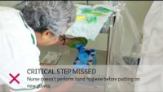

Slide 5
Why is Aseptic Technique Important?
According to the national point prevalence survey, the prevalence of Healthcare-associated infection was 6.6% in Aotearoa New Zealand.¹
¹ National point prevalence survey of healthcare-associated infections :www.hqsc.govt.nz/resources/resource-library/pps-report-2022
Notes:
Discuss - While it is easy to sit in judgement of the practice of the health professional in the video, we know about 7% of all hospital admissions having a HAI
Educator - Talk Points
Share examples from practice of infections relevant to your or the groups area of clinical practice and the clinical outcomes
Reference National point prevalence survey of healthcare-associated infections :www.hqsc.govt.nz/resources/resource-library/pps-report-2022

Slide 6
Why is Aseptic Technique Important?
To reduce the risk of infection
An infection caused by a procedure can:
    increase pain and discomfort for the patient
    increase length of stay
    expose the patient to the harms of antibiotics
    may require further invasive procedures to treat
    cause death.
Notes:
Discuss
No health care professional intends to do harm to their patients by exposing them to bacteria that can cause infection. That not why we do this job. However poor AT exposes patients to bacteria causing infection which can –

Slide 7
When Should Aseptic Technique Be Applied
Examples of procedures that carry risk include:
    peripheral IV cannula (PIVC) insertion
    urinary catheter insertion
    central line insertion and maintenance
    wound care management
    chest drain, ascitic tap, lumbar puncture.

Slide 8
Audit Pass Rates For Each Procedure Across 4 NZ Hospitals
Notes:
Discuss
Results from 2019 AT audit undertaken by IPC experts of both medical and nursing staff across 4 hospitals (public and private)
Things that have had a focus put on AT when taught (e.g. IDC insertion) are done really well
Procedures that have become routine and are performed frequently have lost the AT emphasis (e.g Accessing line)
All procedures are equally at risk of giving a patient a Hospital acquired infection if AT not followed.

Slide 9
Out of the 118 procedures there were 72 breaches
Notes:
Discuss
Staff knew they were being audited so were on their ‘best behaviour” – what was their normal practice?
Audit emphasis hand hygiene importance
Even when being watched, ‘worse case’ examples of contamination occurred e.g. critical parts being contaminated

Slide 10




Four Principles of Aseptic Technique
Preparation
Key parts
Key sites
Advice
Which are underpinned by hand hygiene

Slide 11


To adhere to the principles of aseptic technique, hand hygiene must be performed multiple times during any procedure.
Examples include:
before equipment set up
immediately before commencing the procedure
whenever gloves are changed
and after the procedure is completed
Notes:
Discuss
Based on WHO 5 moments of hand hygiene
Hand gel or soap and water but both must cover every surface of hand and wrist
Gloves even sterile gloves do not replace hand hygiene.

Slide 12
Important Definitions
Work surfaces - The surface where equipment will be placed and where you will work from during the procedure. Work surfaces should be cleaned before use. Work surfaces can include equipment trays or dressing trolleys.
Aseptic field - Defined area made with a sterile drape which is used to protect key parts from contamination e.g. the inside of a dressing pack.
Protective packaging - Sterilised equipment packaging or caps which protect a key part by directly covering it.
Notes:
Discuss
Each definition providing examples. Aim to include examples that a relevant to the group.

Slide 13

Preparation is an important step in aseptic technique. Taking the time to prepare the environment, patient and equipment reduces the chance of contamination and help you perform the task more efficiently.

Slide 14
Plan
    Go over the procedure in your mind or with procedure guidelines and/or local policy
Prepare
    Patient, environment and equipment
Sequence
    Plan order of event, aiming to undertake dirty task before clean
Decide
    What you will use for a work surface
    If you will protect key parts by using protective packaging or an aseptic field
    If you need sterile gloves to protect key parts or key sites
    If you need an assistant to help with the procedure or help the patient
    Where will you place rubbish so that it does not pass over or touch the work surface
Notes:
Discuss
Plan using procedure manuals and local policies - (educator refer to your organisation/areas specific manuals/policies.)
Prepare - Patient – consent. - Environment – examples such as remove open commode , move bedding/ clothing , lanyard and hair out of the way. Equipment – gather the equipment required
Sequencing – use of procedure manuals. Aim to undertake dirty task before clean
Decide – Work surfaces - discuss types. How key parts will be protected. Gloves – discuss when to use sterile vs non sterile. Assistant – patient unable to maintain position ie needs leg held, confused patient – risk of touching. Rubbish Placement - not pass over or touch the work surfaces

Slide 15

Key parts are the parts of the equipment which breach the skin or have contact with sterile fluids or key sites.

Slide 16
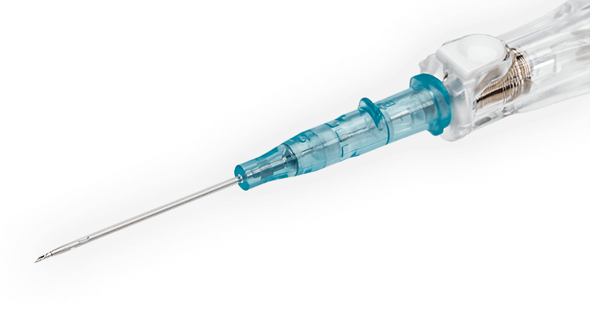
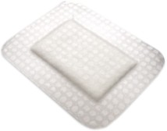
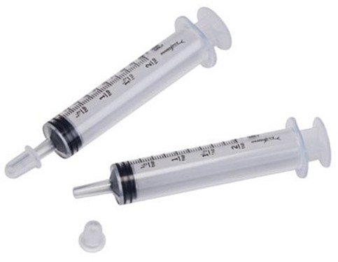
Key part
Key part
Key part
Key part

Slide 17

- How to protect them
Perform hand hygiene before equipment set up
Perform hand hygiene again before starting the procedure (immediately before putting on gloves)
Use protective packaging or an aseptic field immediately before use
Key part attached to patient
    Clean prior to use with appropriate antiseptic
    Allow antiseptic to dry
Avoid touching
If you cannot avoid touching the key part, then only touch with uncontaminated sterile gloves or forceps. Even with sterile gloves or forceps any touching should be limited and purposeful.
Notes:
Discuss
Examples of how protective packaging can be used to protect key parts (educator could demonstrate with actual examples)
Aseptic field with examples (educator could demonstrate with actual examples)
Given examples of Key parts attached to patient
Antiseptic use including allowing to dry
Avoid touching
Appropriate glove use
Reminder hand hygiene

Slide 18

Key sites are sites on the body where the normal skin barrier is breached.
Notes:
-

Slide 19
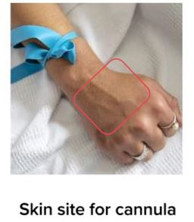
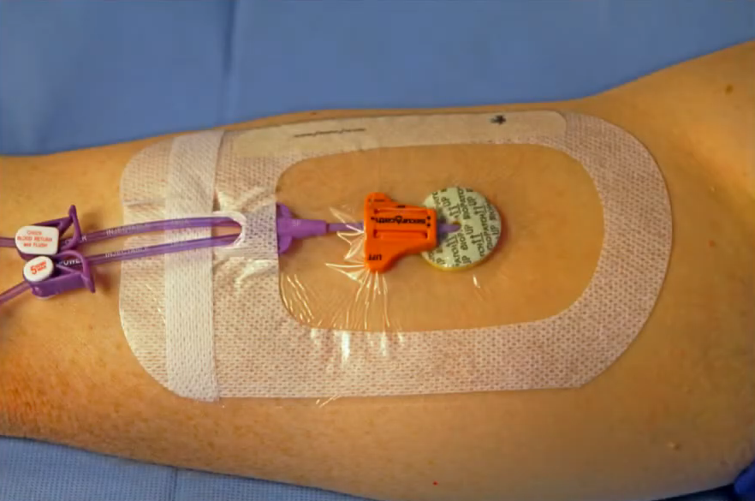
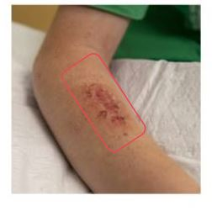
Skin site for cannula
Peripherally inserted central catheter (PICC) exit site.
Wound to be dressed

Slide 20
- How to protect them
Perform hand hygiene before equipment set up
Perform hand hygiene again before starting the procedure (immediately before putting on gloves)
Key sites need to be cleaned prior to use with appropriate antiseptic/solution
Allow antiseptic/solution to dry and do no retouch
Avoid directly touching
If you cannot avoid touching the key site, then only touch with uncontaminated sterile gloves, sterile forceps or sterile products. Even then any touching should be limited and purposeful.
Notes:
Discuss
Cleaning of Key sites including allowing to dry
Avoiding touching
Appropriate glove use – provide clinical examples of when to choose different gloves. Use examples relevant to workplace
Reminder hand hygiene

Slide 21

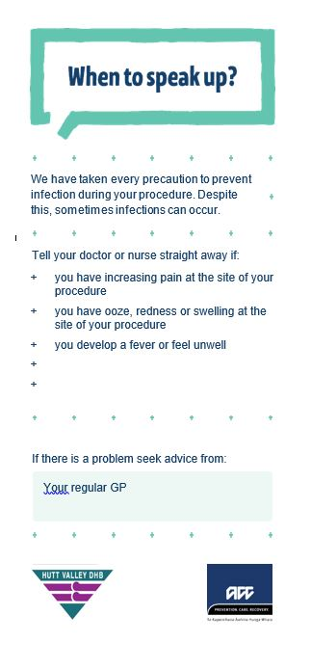
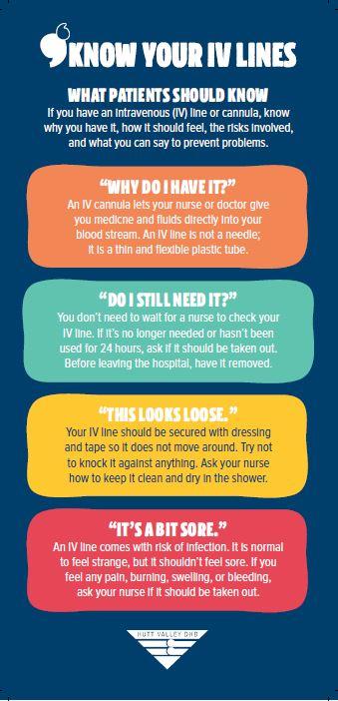
Provide advice to patients and whānau about:
how to care for the procedure site
what signs of complication
when and how to contact a health professional.
Ideally this should be written.
Notes:
Discuss
Reminder hand hygiene
Including patient, whānau other health care professionals
Importance that advice is procedure specific
Includes signs and symptoms of complications
How and when to contact health professional
Ideally written but client appropriate
If relevant uses examples of advice sheets that are already available in specific organisation/workplace

Slide 22
What if a breach occurs?
It's ok … but to minimise risk to the patient, you need to start again.
If you see breach politely say something, and assist your colleague to start again
Notes:
Discuss
Its ok …. No matter how experienced you think you are you are human; mistakes happen. Our patient and the environments we work in are not predictable – breaches occur. However, what we do next is important. To minimise risk to the patient, need to start again.
If you see a breach politely say something and assist colleague to start again. If I colleague points, you have made a mistake don’t let your ego put your patient at risk, thank them and start again.
Activity
- Ask for group to suggest ways they might politely “say something”

Slide 23
Four Principles of Aseptic Technique
Preparation
Key parts
Key sites
Advice
Which are underpinned by hand hygiene

Slide 24
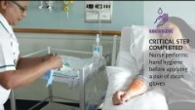

Slide 25
Aseptic Technique Tool
A copy of the aseptic technique tool will now be given to you
This tool comprises the 10 essential actions which must occur when performing a procedure in order to adhere to the four principles of aseptic technique
Breach of any of these components has the potential to cause microbial contamination leading to infection

Slide 26
Wound Dressing
The following video shows a healthcare worker dressing a wound
See how well the person adheres to the principles of aseptic technique
How many breaches do you see?
Notes:
Activity
Play video and get the group find the errors

Slide 27
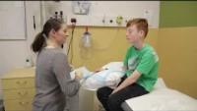

Slide 28
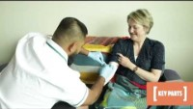

Slide 29
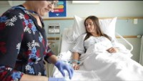

Slide 30
Disclaimer: This is a teaching resource demonstrating the principles of NZAT. Please follow your local procedures/protocols/guidelines.

Slide 31




Made in collaboration with:
With support from ACC

